Slide 1
Online Shopping
Made By:
Himalay Joriwal (iit2011115)
Vikash Sandhu (iit2011209)
Atul Vaibhav (iit2011208)

Slide 2
Objective:
Develop an on-line shopping system for Metro Credit Union (MCU)

Slide 3
Main Features:
User friendly online shopping functionality
Stores inventory and sales information in database reducing human efforts.
Provides great interface for MCU admins to easily analyze members Invoice and update the inventory.
A system that is easy to maintain and upgrade !

Slide 4
Technology Used:
Oracle
Java
Swing
JDBC for Oracle Connectivity.

Slide 5
Database
We have following 6 tables in our database
Admin_table
Customer
Category
Invoice
Item_table
Log_Table

Slide 6
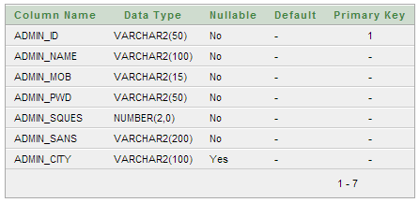
Admin Table
It saves the information about the Administrators.

Slide 7
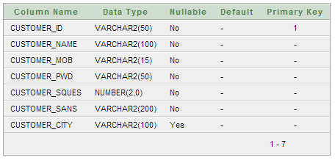
Customer
It saves the information about customers.

Slide 8

Category
It stores the list of all categories into which all items are divided.

Slide 9
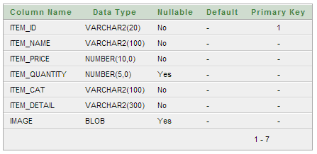
Item Table
It saves the data related to all the products.

Slide 10
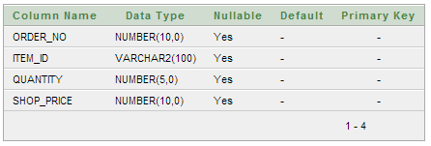
Invoice
This will save the Invoice for all purchases.

Slide 11
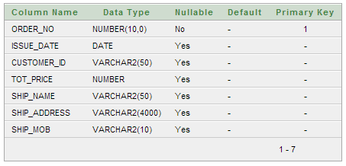
Log Table
It saves the shipping and transaction details for all transactions.

Slide 12
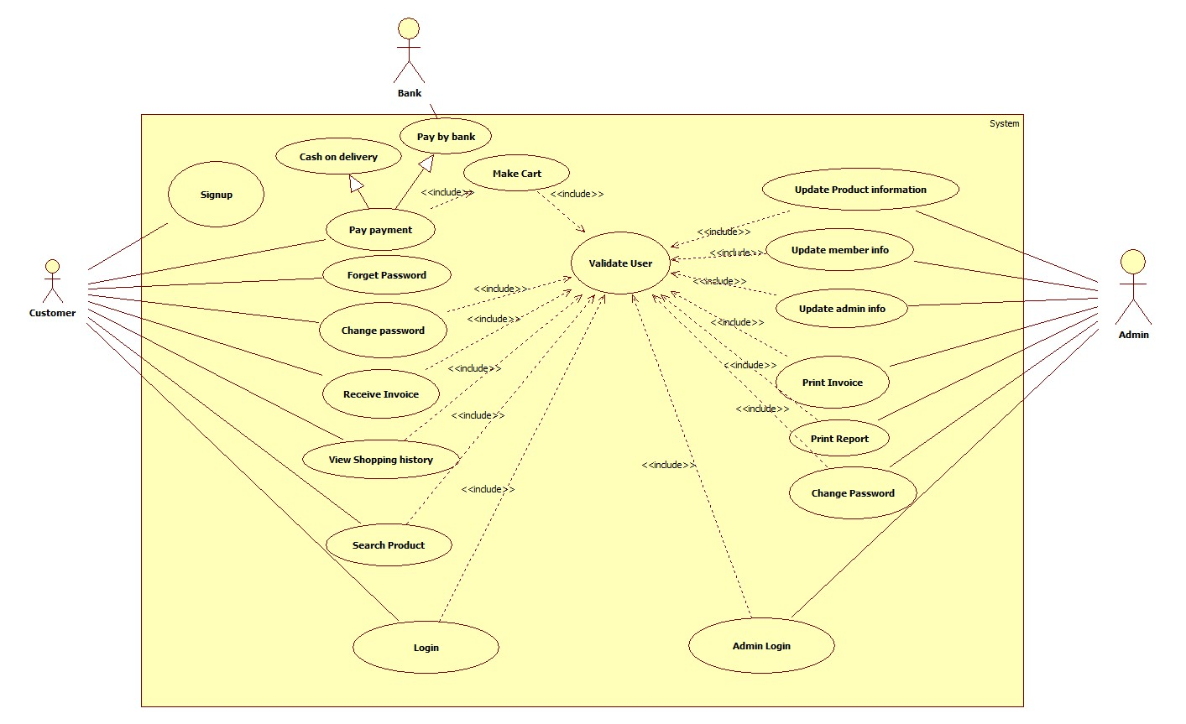
Use Case Diagram

Slide 13
Class Diagram
The class diagram is split into three Major parts for a simpler and quick understanding of this Project.
The three parts are:
Login Class: it deals with user Login, Signup and Forgot Password
Admin Class: It provides the interface for administration of the Online Shopping System to analyze-update inventory.
Shopping Class: It is the main class which provides all members an Online Shopping Cart plus many options like view history, Update profile, Print Invoice, etc.

Slide 14
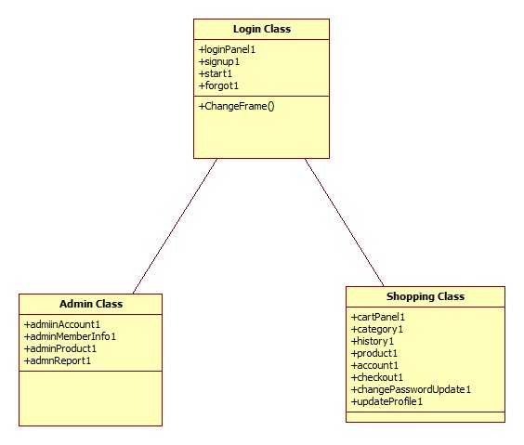
Overview of three main classes

Slide 15
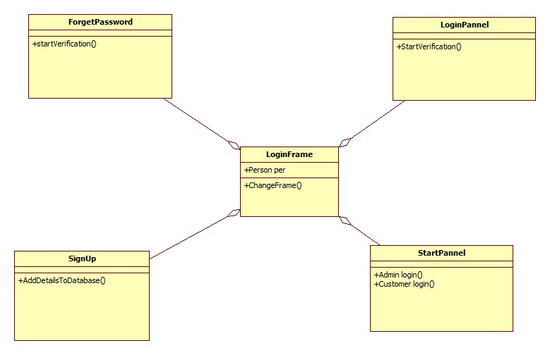
Login Class

Slide 16
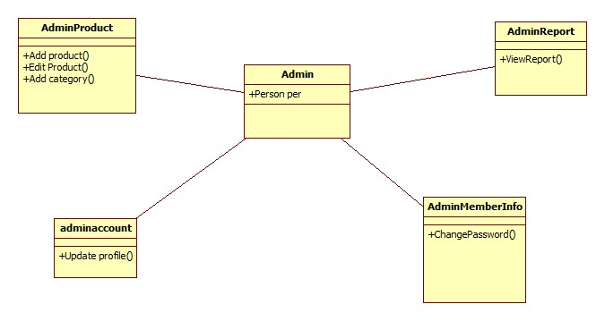
Admin Class

Slide 17
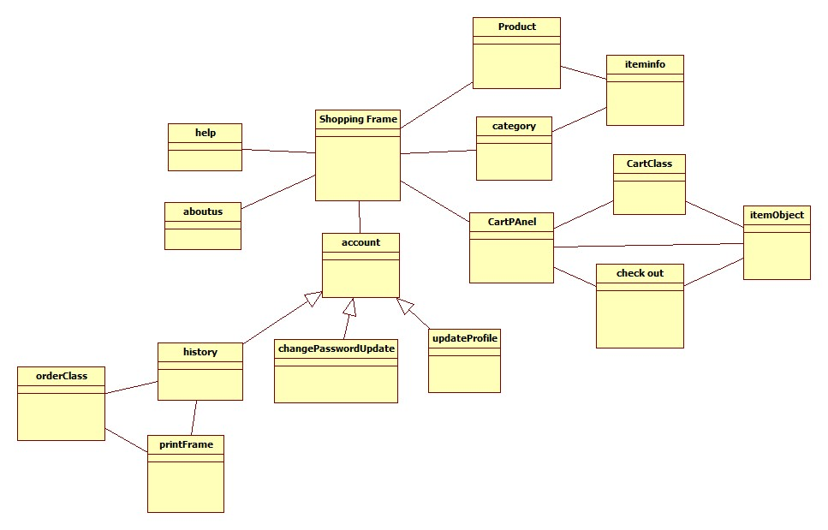
Shopping Class

Slide 18
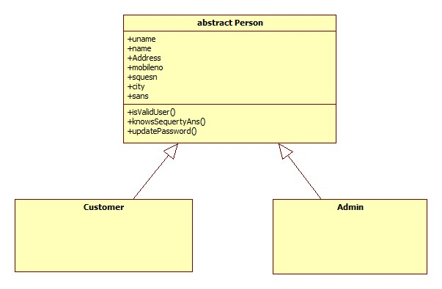
Class Diagram for Person Class

Slide 19
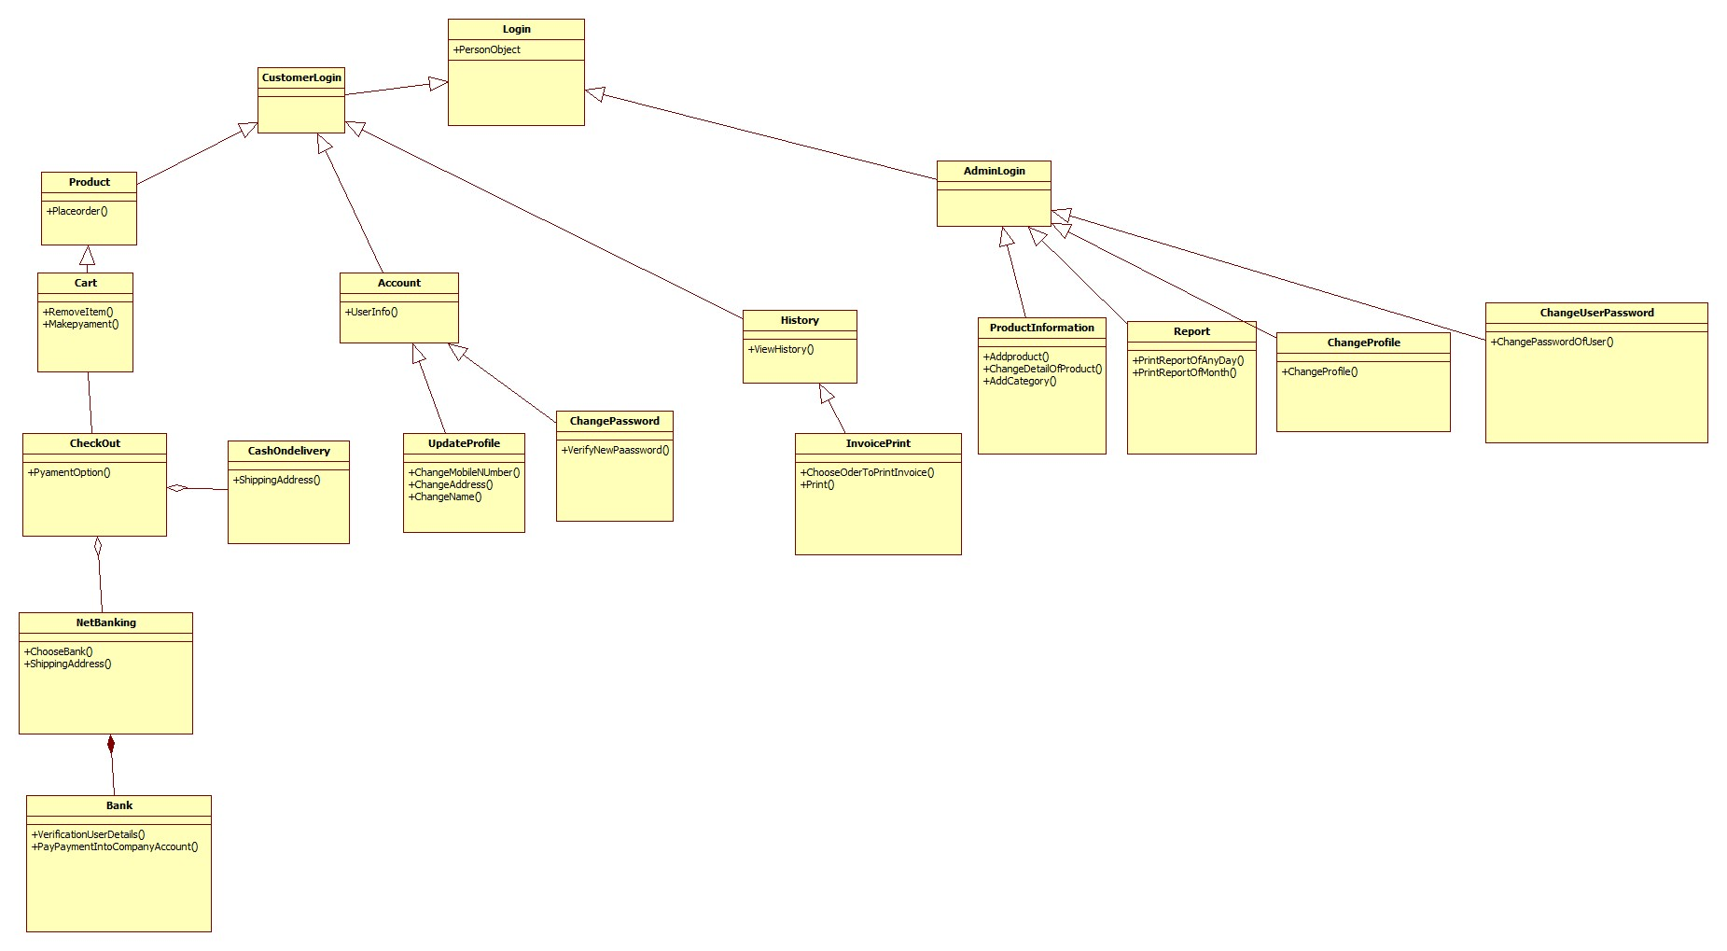
Complete Overview: Class Diagram

Slide 20
CRC Diagram

Slide 21
Responsibilities Collaborations
CRC for class Login
Allows verification of user.
Facilitates Signup for new Users.
Provides Forgot-Password for members.
Makes Distinction between customers and Administrators.
Person, Customer, Admin
Signup
ForgotPassword
StartPage

Slide 22
Responsibilities Collaborations
CRC for class Admin
Update information of product.
Update information of members.
View reports/invoice
Update profile
AdminProducts, ItemClass
Customer
AdminReport, PrintInvoice
UpdateAccount

Slide 23
Responsibilities Collaborations
CRC for class Shopping
Shop Online.
Manage Account
View/Print history
Payments/ Transactions
Product, category
Account, UpdateProfile, ChangePassword
PrintInvoice, OrderClass
CartClass, CheckOut, NetBankingClass

Slide 24
Thank You !!

